Slide 1

BASIC INCOME
European union OPINION POLL
Ironhack madrid
Data analysis
project I

Slide 2
project scope
Objective:
Data analysis about the Basic Income along the European Union countries
Data origin:
      Poll database
      9649 registers
      15 information fields
Data enrichment:
    Country names linked to official country codes through web scraping
    Job titles linked to job codes through API calls
Requirements:
Data pipeline script launched from terminal, accepting parameters such raw data path, country to be analyzed (or all countries)
Output:
      .csv file with information about country, job title, gender, quantity and percentage
      .csv file with information about vote intention and number of pro and against arguments
      .csv file with information about the top jobs related to education level
Extras:
      Charts generated about gender distribution, vote intention and top jobs
      PDF reporting including the charts
      Passing an email address as argument when launching the pipeline results in sending an email containing the PDF report and the main .csv file.
      Related #hashtag search in Twitter
BETA

Slide 3
project stack
    ArgParse
    Raw DataBase
    API info
    Web scraping
Acquisition
Wrangling
Analysis
Reporting
    Pandas
    SQL Alchemy
    Requests
    Beautiful Soup
    Pandas
    RegEx
    Pandas
    Numpy
    Pandas
    Configparser
    Seaborn
    PIL
    SMTP lib
    DB tables extracted
    Job titles referred to its unique ID
    Country names referred to its code
    Charts saved as .jpeg
    PDF report containing the charts
    Email sending
    Wrangled and normalize data as unique .csv file
    3 different .cvs files, each containing one of the performed analysis

Slide 4
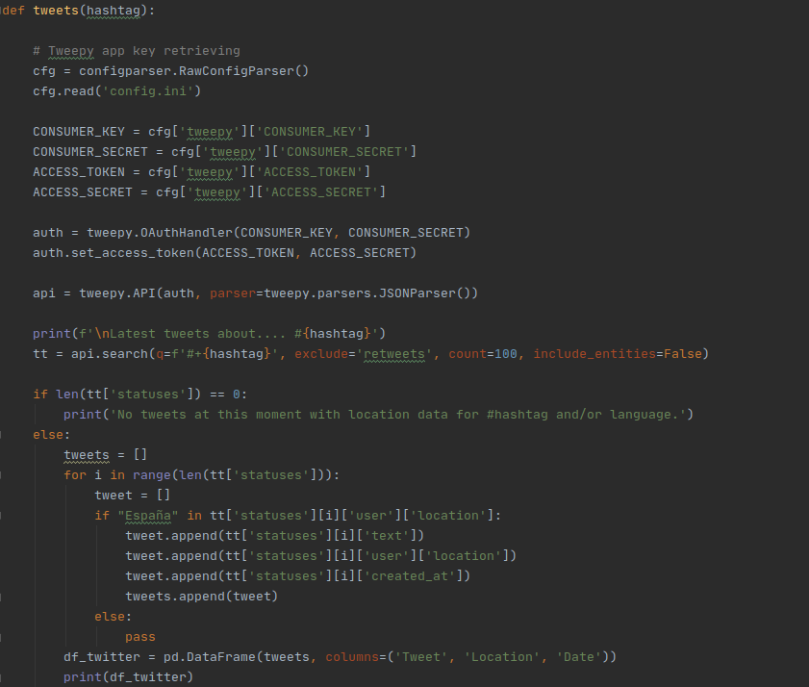
Code snippet

Slide 5


